Slide 1


EXPLORING AI
OVERVIEW OF GENERATIVE AI
BY
Nidhi Sinha

Slide 2


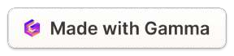
AGENDA
Evolution of AI
GenAI in NLP- LLMs
GenAI in Images -Diffusion Models Deep Dive into LLMs
Limitations & Considerations Sample Application

Slide 3

1950
1956
1980
Alan Turing publishes "Computing Machinery and Intelligence," which proposes the Turing Test as a way to measure machine intelligence.
John McCarthy coins the term "artificial intelligence."
The Dartmouth Summer Research Project on Artificial Intelligence is held, which is considered to be the start of the modern field of AI.
The first expert system, MYCIN, is developed. Expert systems are AI programs that use knowledge and rules to solve problems in a specific domain.
1997
2011
2012
Deep Blue, a chess-playing computer developed by IBM, defeats Garry Kasparov, the world chess champion. This is considered to be a major milestone in the development of AI.
The first large language model, GPT-1, is developed by OpenAI. GPT-1 is a neural network that can generate text, translate languages, and answer questions.
AlexNet, a convolutional neural network, wins the ImageNet Large Scale Visual Recognition Challenge. This is considered to be a major breakthrough in the field of computer vision.
2016
2022
AlphaGo, a Go-playing computer developed by Google DeepMind, defeats Lee Sedol, the world Go champion. This is considered to be a major milestone in the development of AI.
Large language models (LLMs) such as GPT-3 and Jurassic-1 Jumbo have become increasingly powerful and versatile. They can now generate text, translate languages, write different kinds of creative content, and answer your questions in an informative way.

Slide 4


What Is GenAI?
GenAI is short for "Generative Artificial Intelligence," which refers to AI systems that can generate human-like text based on input prompts(includes texts/images/audio&videos).
For example 😅
User: "Can you come up with a clever tech pun?"
GenAI: "Sure, here's one for you: Why do programmers prefer dark mode? Because light attracts bugs, but darkness keeps them in 'byte'!"

Slide 5

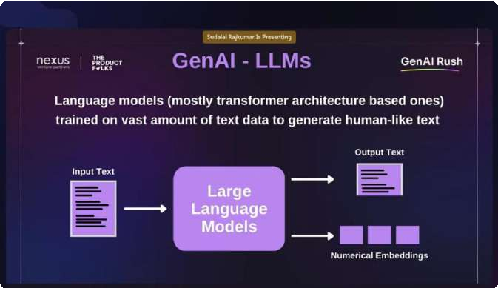

GenAI - LLMs 🤔
Examples of LLMs 👇
GPT-3: GPT-3 is a large language model developed by OpenAI.
LaMDA: LaMDA is a large language model developed by Google AI.
Jurassic-1 Jumbo: Jurassic-1 Jumbo is a large language model developed by DeepMind.
Large language models (LLMs) are a type of artificial intelligence (AI) that are trained on massive datasets of text and code. They can be used to generate text, translate languages, write different kinds of creative content, and answer your questions in an informative way.

Slide 6

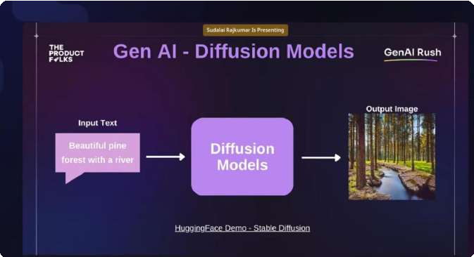
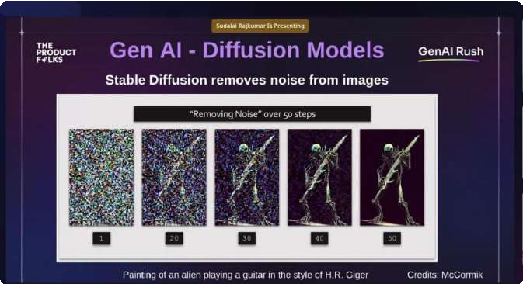

GenAI - Diffusion Model
Image diffusion models are trained on a dataset of real images. The model learns to identify the features that make up a real image, and it uses this knowledge to generate new images that are similar to the real images in the dataset.
Example- 🦊 DALL-E 2 Imagen 🦝
How Stable Diffusion Remove Noise from Images?
Stable diffusion is a type of image diffusion model that can be used to remove noise from images. It works by starting with a noisy image and then gradually adding noise to the image until it becomes a smooth, noise- free image.
VQ-GAN 🐺

Slide 7

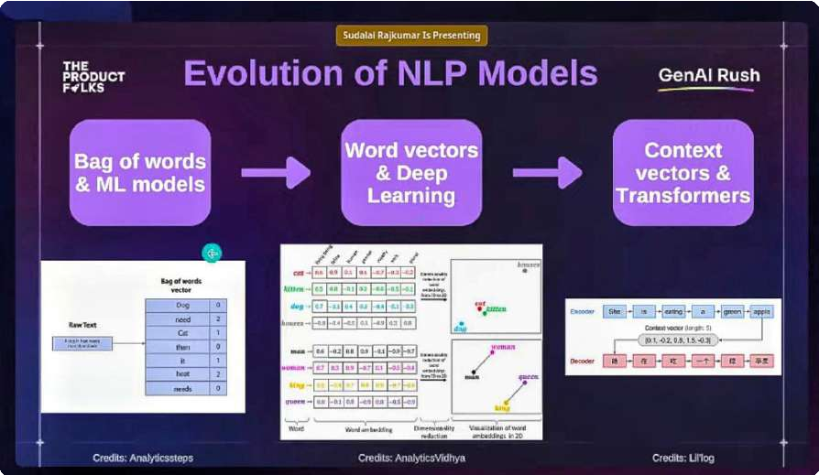

Let's Deep Dive Into LLMs
Evolution of NLP Models
Bag-of-words models: The first stage of NLP modeling was based on the bag-of-words (BoW) approach.In BoW, each word in a document is represented as a unique integer.
Word vectors and deep learning: The second stage of NLP modeling was based on the use of word vectors. Word vectors are real-valued vectors that represent the meaning of words.
Context vectors and transformers: The third stage of NLP modeling is based on the use of context vectors and transformers. This means that context vectors can capture the meaning of words in a more nuanced way than word vectors.Transformers are a type of neural network that is specifically designed for NLP tasks.

Slide 8

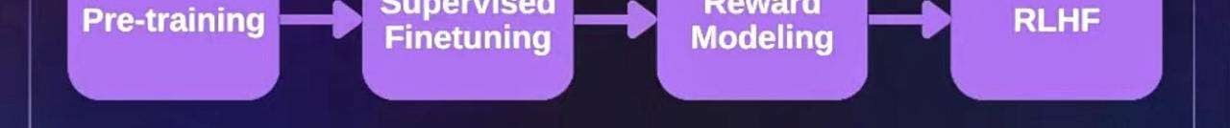
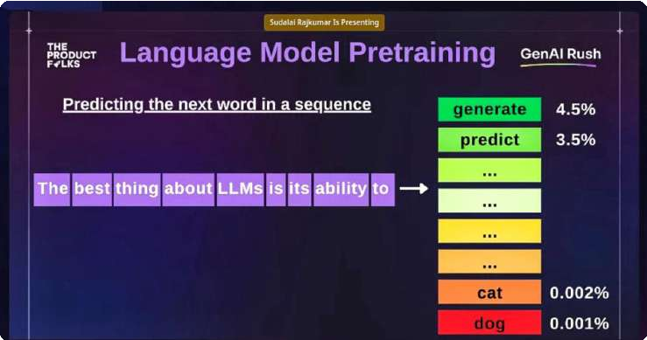

Language Model Pretraining
Language model pretraining is a technique used to train large language models (LLMs). LLMs are a type of neural network that can be used for a wide range of natural language processing (NLP) tasks, such as text generation, translation, and question answering.
Heating maps can be used to visualize the predictions of an LLM. In a heating map, the words in a vocabulary are represented as points on a grid. The intensity of the color at each point represents the probability that the LLM will predict that word.

Slide 9


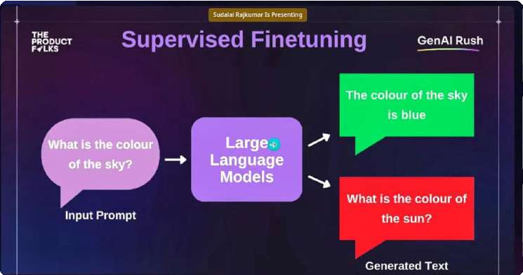

Supervised Finetuning
Supervised finetuning is a technique used to improve the performance of a language model on a specific task. In supervised finetuning, the language model is first pretrained on a large corpus of text. Then, the language model is finetuned on a dataset of labeled data that is specific to the task.
The language model would be finetuned to learn the relationship between the appearance of the sky in an image and its color label.
For example 🌟 the language model would learn that the sky is typically blue during the day and that it is typically orange during sunset. After the language model has been finetuned, it would be able to predict the color of the sky in a new image with a high accuracy.

Slide 10

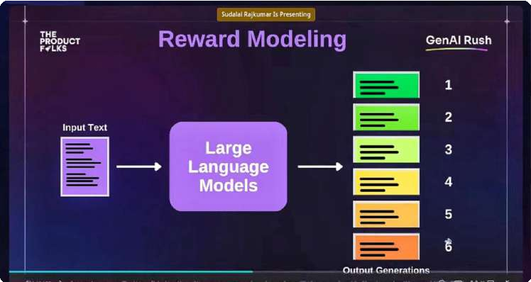

Reward Modeling
Reward modeling is a technique used to train large language models (LLMs) to behave in a desired way.The LLM is trained to maximize the expected reward signal. This means that the LLM will learn to take actions that are more likely to be rewarded.
Reward modeling can be used to train LLMs to perform a variety of tasks, such as generating text, translating languages, and answering questions.
For example 🌟 An LLM that is trained to generate text can be rewarded for generating text that is factual, coherent, and grammatically correct.

Slide 11
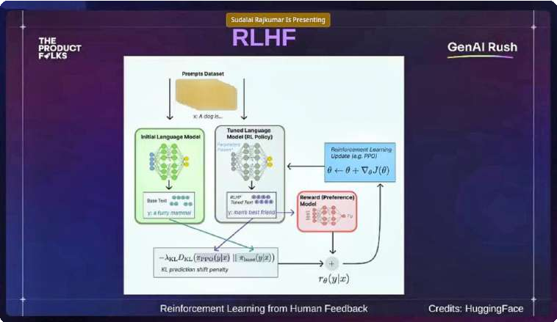

RLHF(Reinforcement Learning From Human Feedback)
Reinforcement learning from human feedback (RLHF) is a technique that combines reinforcement learning and human feedback to train agents to perform tasks.
In RLHF, the agent is given a reward signal for taking actions that are consistent with the desired behavior.
For example 🌟 An agent that is trained to play a game can be rewarded for taking actions that lead to winning the game. The human can provide feedback on the agent's actions, and the agent can use this feedback to learn how to play the game better.

Slide 12


Considerations & Limitations
1 Ambiguous inputs
🤨
2 Ambiguous outputs 🫥
Can also generate ambiguous outputs.
3 Inconsistent results 😬
This is because LLMs are trained on a massive dataset of text and code, which can include different interpretations of the same concept.
LLMs can be trained on a massive dataset of text and code, which can include ambiguous or contradictory information.
For example 🌟 If an LLM is asked to summarize a factual text, it may generate a summary that is both factualand fictional.
For example 🌟 If an LLM is trained on a dataset of both factualand fictional text, it may generate outputs that are a mix of both.
For example 🌟 If an LLM is asked to translate a sentence from English to French, it may generate different translations depending on the training data it was given.

Slide 13


Considerations & Limitations
1 Hallucinations 🫢
2 Privacy information 🤐
LLMs can be trained on a dataset of text and code that includes private information.
3 Performance, Latency, and Cost
🤔
LLMs can generate outputs that are completely fabricated.
This is because LLMs are trained on a massive dataset of text and code, which can include information that is not real.
Can be computationally expensive to train and run. This is because they require a large amount of data and computationalresources.
This information could be leaked if the LLM is not properly secured.
For example 🌟 If an LLM is asked to write a poem about a unicorn, it may generate a poem that describes a unicorn that does not exist.
For example 🌟 If an LLM is trained on a dataset of emails, it could learn the emailaddresses of the people who sent the emails.
LLMs can also have latency issues. This means that there can be a delay between the time an LLM receives an input and the time it generates an output.

Slide 14

Considerations & Limitations
1
Reasoning & arithmetic computations
LLMs are not very good at reasoning or performing arithmetic computations.
2 Knowledge cutoff
LLMs are trained on a massive dataset of text and code, but this dataset is finite.
This means that LLMs will not be able to answer questions that are outside of the scope of the dataset they were trained on.
For example 🌟 If an LLM is trained on a dataset of news articles, it will not be able to answer questions about physics.
This is because they are trained on a massive dataset of text and code, which does not include a lot of information about how to reason or perform arithmetic computations.

Slide 15
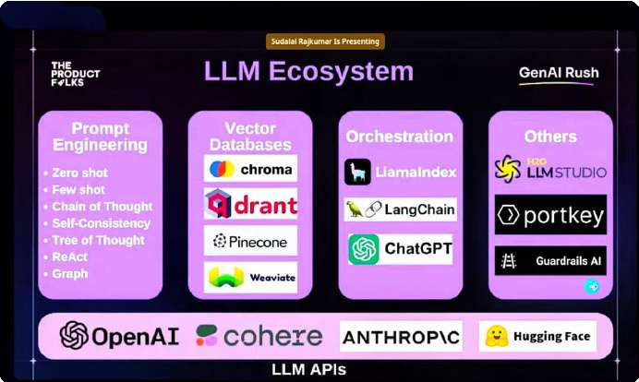

LLM Ecosystem
The LLM ecosystem is the environment in which large language models (LLMs) are developed, trained, and used. It includes the people, organizations, tools, and resources that support the development and use of LLMs
The LLM ecosystem is constantly evolving as new LLMs are developed and new tools and resources are created.

Slide 16

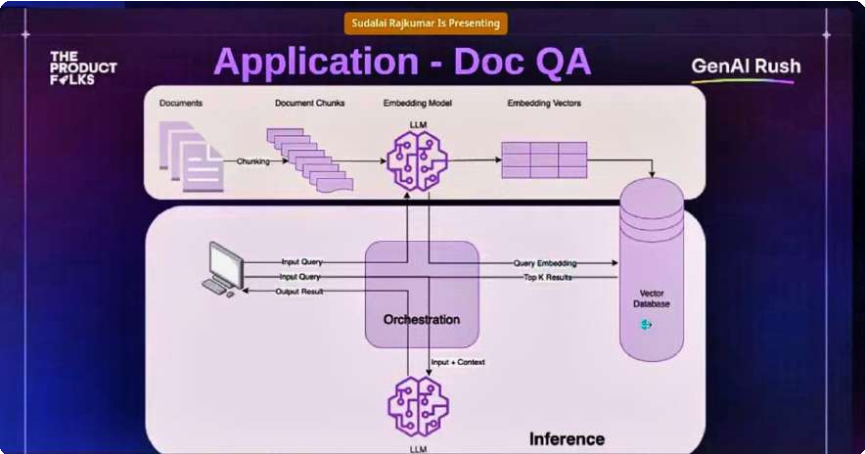

Application
Overall, the processes of documentation, churning, document chunks, embedding model (LLM), embedding vectors, vector database, and orchestration can be used to create a powerful system for managing and querying documentation. This system can be used to improve the efficiency, accuracy, and accessibility of documentation.

Slide 17



References
https://blog.streamlit.io/langchain-t...
https://a16z.com/2023/06/20/emerging-...
https://www.promptingguide.ai/ https://huyenchip.com/2023/06/07/gene... https://docs.cohere.com/docs/introduc... https://mccormickml.com/2022/12/21/ho... https://writings.stephenwolfram.com/2... https://huggingface.co/blog/rlhf

Slide 18


Thank You…
If you made this far 🫡 👍
Learning is like a box of chocolates 🍫 Sometimes you'll get the nutty ones, sometimes the gooey ones, and occasionally, you'll bite into a mystery 🧐 filling that makes you question the laws of flavor.
But keep exploring, because each piece brings you closer to that moment of sweet, delicious knowledge!"
Happpy Learning!!

